Slide 1

Career Exploration Announcement Before TA Lesson:
Eat with an expert once a month in Lecture Hall
Jan. 19 period 6: Careers with US Army Corp of Engineers
You must sign up by noon on Jan. 17th or you will not be able to attend.
  Feb. 9 period 7: Electrician
  March 9 period 1: Careers in Aviation
  April 13 period 2: Careers with Children’s Hospital & Med Center
  Must sign up on link: Eat With An Expert

Slide 2
TA COLLEGE AND
CAREER PLANNING
MY GAME PLAN SURVEY

Slide 3
WHAT IS MY GAME PLAN?
MY GAME PLAN IS A SURVEY TO HELP YOUR EXPLORE WHAT YOUR FUTURE GOALS ARE
IF YOU DON’T KNOW WHAT YOUR FUTURE GOALS ARE OR IF YOU ARE STILL EXPLORING YOUR OPTIONS, “MY GAME PLAN” WILL HELP YOU START TO ASK THOSE IMPORTANT QUESTIONS
THERE IS NO RIGHT OR WRONG ANSWER, IT IS JUST “YOUR ANSWER” SO LET'S GET STARTED
LOG INTO YOUR NAVIANCE ACCOUNT

Slide 4

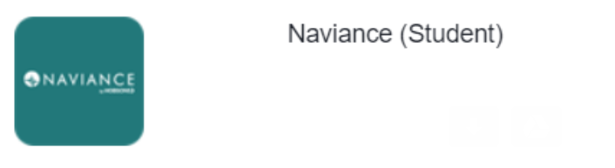
New Naviance Login Directions
    Go to ClassLink: http://launchpad.classlink.com/elkhorn
    Click on the following Icon and you should automatically be logged in to Naviance:

Slide 5
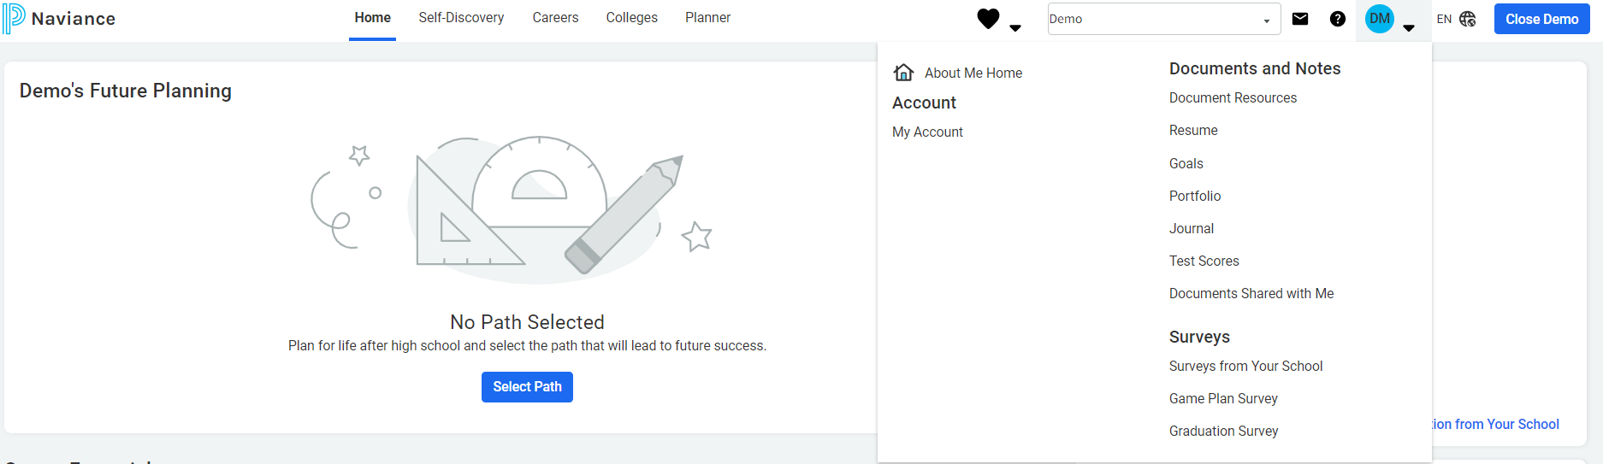
TO ACCESS “MY GAME PLAN SURVEY” Click the down arrow by your initials THEN CLICK “GAME PLAN SURVEY”

Slide 6
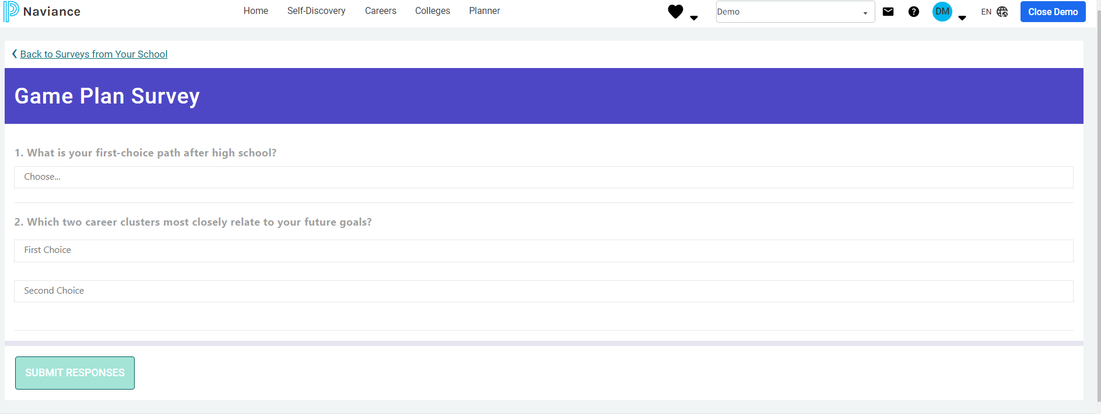
Follow the prompts to answer the questions:

Slide 7
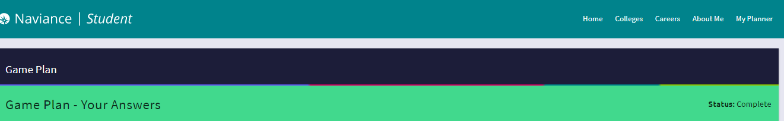
WHEN YOU ARE FINISHED..
When you are finished click “save changes and I am finished”
When you look at the top of the page it should indicate status: Complete

Slide 8
YOU WILL CONTINUE TO HAVE OPPORTUNITIES TO EXPLORE YOUR COLLEGE AND CAREER OPTIONS IN TA, FEEL FREE TO NAVIGATE THROUGH NAVIANCE ON YOUR OWN
☺

