Slide 1

Career Exploration Announcement Before TA Lesson:
Eat with an expert once a month in Lecture Hall
September 14: Careers in the Military (Air Force & Army)
  September 14th-Thursday
  1st Period-Careers in the Military (Air Force & Army)
  October 12th-Thursday
  2nd Period-Careers in the Performing Arts
  November 9th-Thursday
  3rd Period-Careers in Fire Science & Rescue
  December 14th-Thursday
  5th Period-Careers in Engineering
  Must sign up on link: Eat With An Expert
1

Slide 2
STRENGTHS
NAVIANCE STRENGTHS EXPLORER by GALLUP

Slide 3


Naviance Login Directions
    Go to ClassLink: http://launchpad.classlink.com/elkhorn
    Click on the following Icon and you should automatically be logged in to Naviance:
3

Slide 4
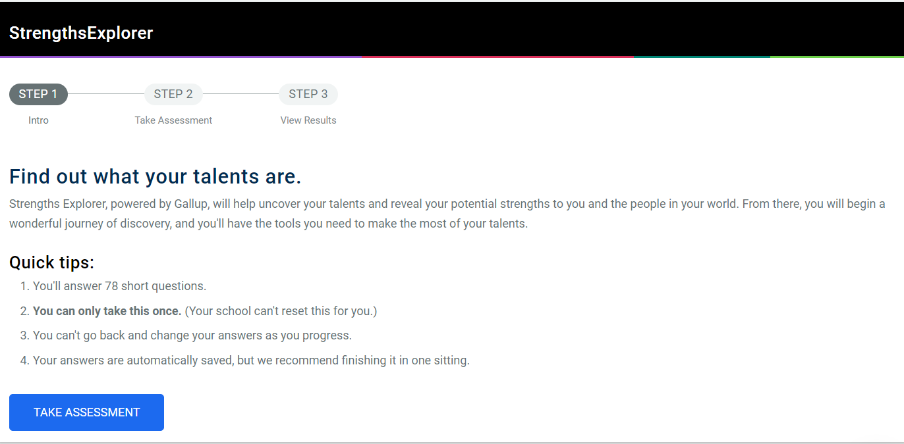
The Assessment

Slide 5
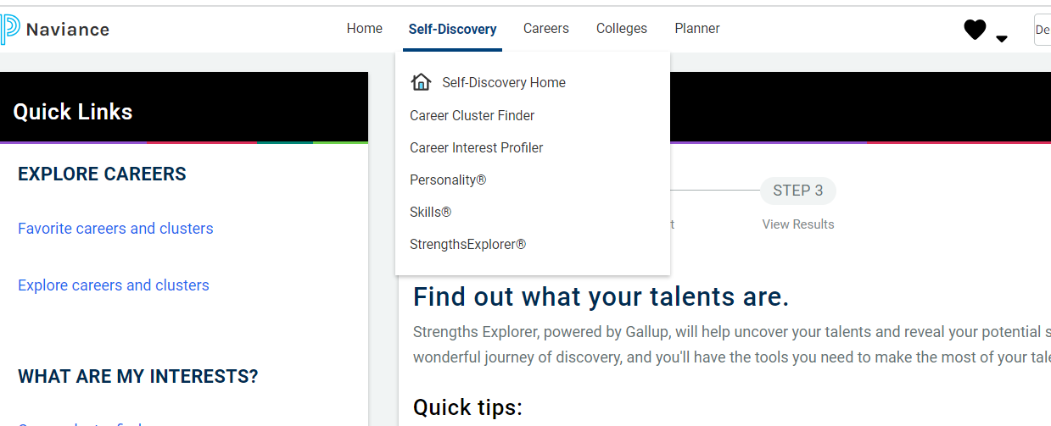
Click on Self-Discovery/StrengthsExplorer
StrengthsExplorer helps discover talents and improve the following:
resilience and confidence in their daily lives
productivity and engagement in school
hope and direction for the future

Slide 6
Possible Themes based on results:
Achieving Discoverer
Competing Future Thinker
Confidence Organizer
Caring Presence
Dependability Relating

Slide 7
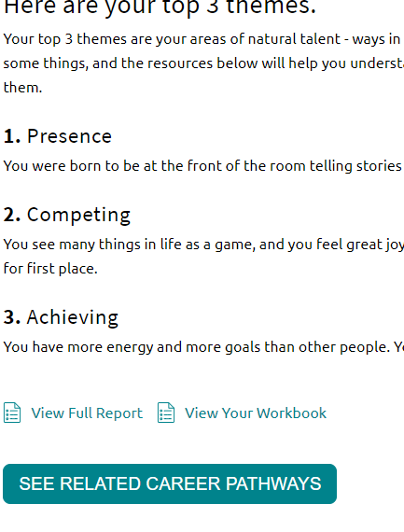
Top 3 Themes
Once you complete the assessment you will be given your top 3 themes. Take time to read these. Then spend time looking at your full report as well as related careers and pathways.

