Slide 1

Career Exploration Announcement Before TA Lesson:
Eat with an expert once a month in Lecture Hall
September 14: Careers in the Military (Air Force & Army)
  October 12th-Thursday
  2nd Period-Careers in the Performing Arts
  November 9th-Thursday
  3rd Period-Careers in Fire Science & Rescue
  December 14th-Thursday
  5th Period-Careers in Engineering
  Must sign up on link: Eat With An Expert

Slide 2
Naviance Student:
Career Interest Profiler

Slide 3


Naviance Login Directions
    Go to ClassLink: http://launchpad.classlink.com/elkhorn
    Click on the following Icon and you should automatically be logged in to Naviance:
3

Slide 4
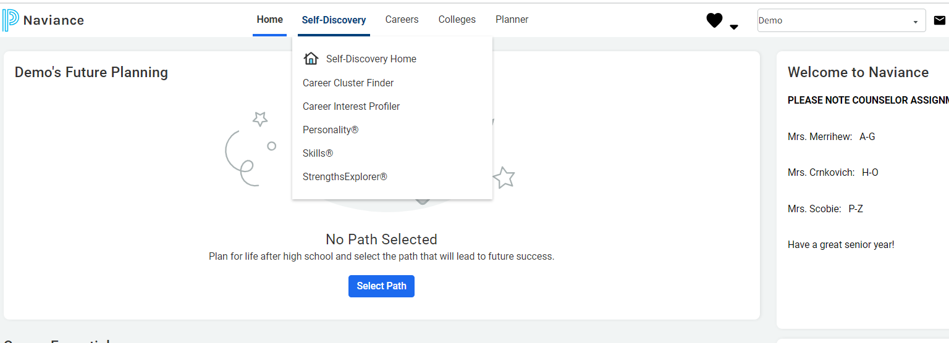
Click on Self-Discovery, then click on Career Interest Profiler
Complete Career Interest Profiler, get a Holland Code, explore careers that match your code.

Slide 5
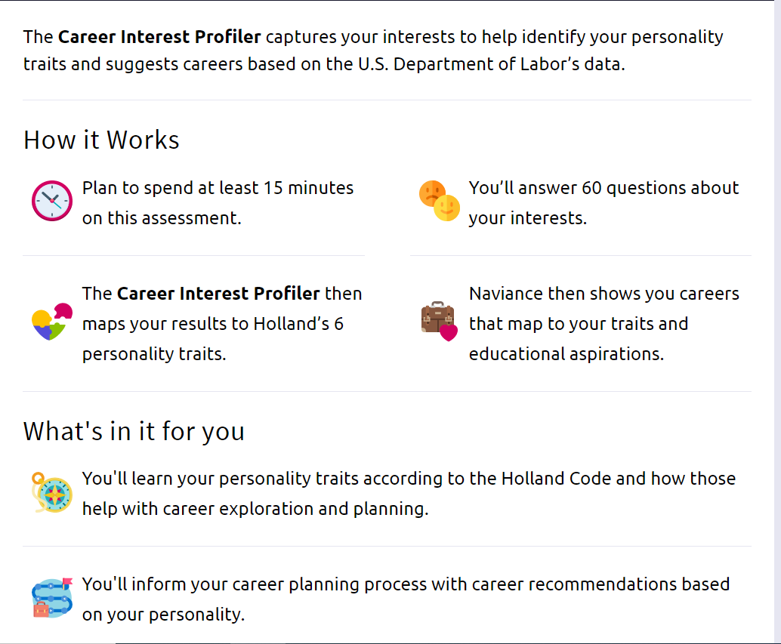
My Holland Code
Once you have completed the Career Interest Profiler, you will see a list of the career types:
Artistic, Conventional, Investigative, Enterprising, Realistic, Social.
The three highest scores are your Holland Codes (Career Types).
Click on the Careers tab and then Explore to research career options and click on your top three career types (Artistic, Conventional, Investigative, Enterprising, Realistic, Social.)

Slide 6
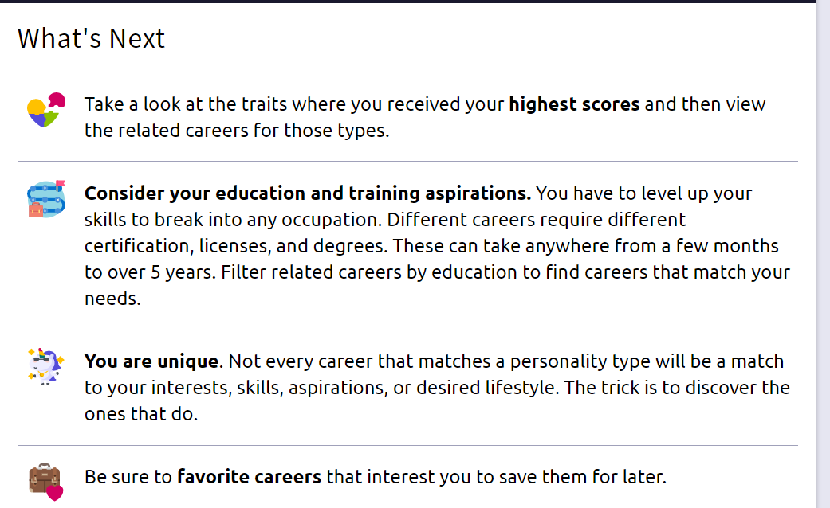

Slide 7
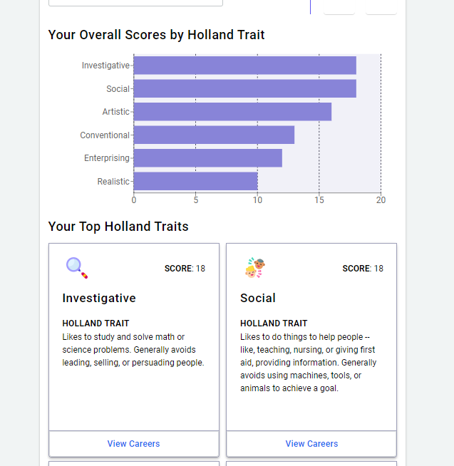
Scroll down to see your top Holland Traits. Click on View Careers.

Slide 8

To receive information about upcoming career events, favorite any careers of interest.
Click on the links to find out more information about each career.

