Slide 1

Eat with an expert once a month in Lecture Hall
  March 9, 1st period: Careers in Aviation
  April 13, 2nd period: Careers with Children's Hospital & Medical Center
Must sign up on link: Eat With An Expert
Career Exploration Announcement Before TA Lesson:

Slide 2
TA COLLEGE AND CAREER PLANNING
Naviance
Resume Builder

Slide 3

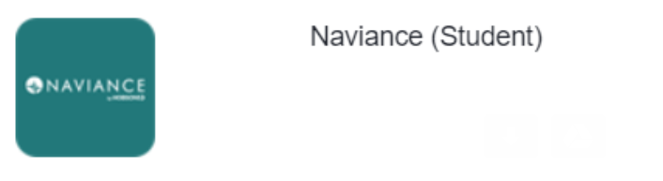
Naviance Login Directions
    Go to ClassLink: http://launchpad.classlink.com/elkhorn
    Click on the following Icon and you should automatically be logged in to Naviance:

Slide 4
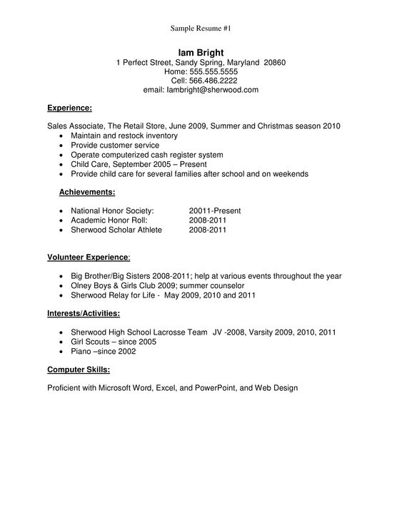
Building a Resume
Simple Example of a High School Student Resume
Important sections to consider:
Personal Information
Education
Volunteer service
Extracurricular activities
Awards/certificates
Skills/academic achievement
Music/artistic achievement
Athletic achievement
Leadership
Additional information
References

Slide 5
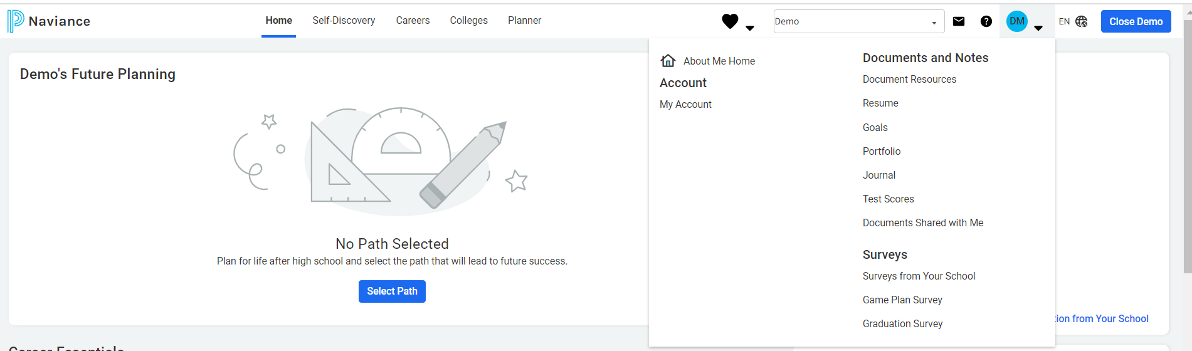
How to create a resume in Naviance
Click on the down arrow by your Initials
Click on “Resume”

Slide 6

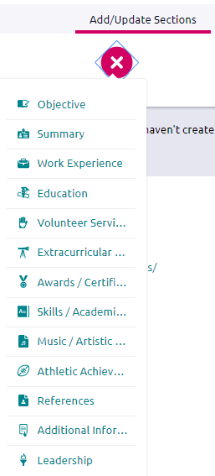
Click on the “Plus” button
Click on Add/Update sections
Click on the “Plus” button to add your sections

Slide 7
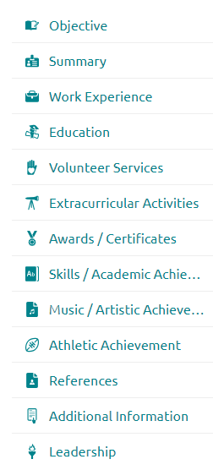
ADDITIONAL OPTIONS
These options are very important for high school students.

Slide 8
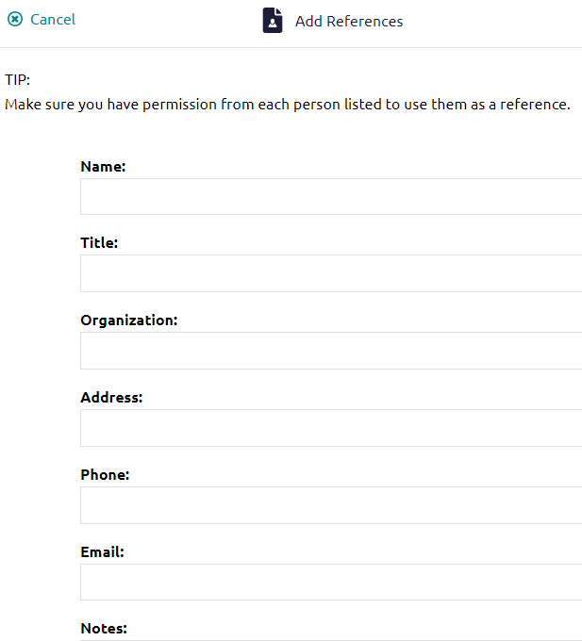
ADDING REFERENCES
References may NOT be family members unless they are your employer.
You must have permission from each person listed to use them as a reference.
References can make a big difference.
Always think about how this person would describe you to others.

Slide 9
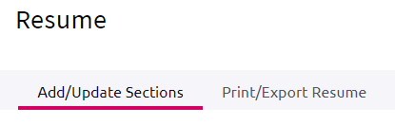
When you have entered all of the categories you want to include, click Print/Export Resume.
Click the plus button.

Slide 10
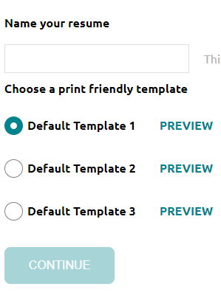
Name your resume. Often is your name such as “Andy Antler’s Resume”.
Choose a template
Click Continue

Slide 11

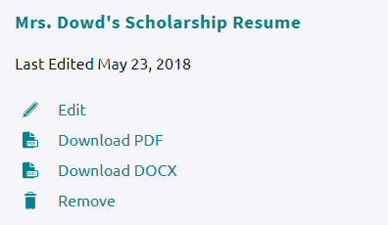
Be sure to SAVE it!
Once it’s saved you can always come back and edit it, download it to email to an employer or college, or print it.
Andy Antler’s Scholarship Resume

Slide 12
THINGS TO REMEMBER
You should update your resume on a regular basis.
You can use different resumes for scholarships, employment, college, etc.
If you need a letter of recommendation from a teacher, please ask them at least two weeks in advance.

